Slide 1






Bootcamp
Jobs in IT
Session 2
Jeans Hernández
07/03/2024

Slide 2


Desarrollo Web Full Stack -
Avanzado
Módulo 1. Welcome / Famous People in IT
Módulo 2. Jobs in IT
Módulo 3. The World of Information Technology IT (1)
Módulo 4. The World of Information Technology IT (2)
Módulo 5. Roles and Tasks in an IT Company
Módulo 6. Virtual calls
Módulo 7. Daily meetings
Módulo 8. CV (Curriculum Vitae) (1)

Slide 3
Table of contents
1
IT Jobs
2
Indirect Questions
3
Vocabulary

Slide 4

Objectives:
IT Jobs
Indirect Questions
Vocabulary
Explore the different IT Jobs that exist, the skills required, their tasks and their specific knowledge to have
Learn the use of simple words related to technology
Understand and create more formal questions using embedded questions

Slide 5
IT jobs
IT jobs involve managing, implementing, and supporting technology systems within organizations. Professionals in IT roles handle tasks like developing software, managing networks, ensuring cybersecurity, maintaining databases, and providing technical support. These jobs are essential for businesses to utilize technology effectively, driving efficiency and innovation across industries.

Slide 6

Reading Activity
Read and extract important information:
EXERCISE
Use Word, PowerPoint, etc

Slide 7
Tech jobs / careers
Investigate for the IT jobs that exist today:
Select one that interest you the most and write a description of the main tasks or responsibilities.
Make a list of the skills, knowledge and tools needed in that career.
Write the complete career path of that profession and the job title you would like to have.
Use Word, PowerPoint, etc

Slide 8
Indirect Questions
Indirect questions are commonly used in information technology contexts for various purposes, such as seeking clarification, requesting assistance, or gathering information. Here are some examples of indirect questions in information technology contexts and their importance:

Slide 9
Indirect Questions
Gathering information and clarifying understanding:
Direct Question: "What are the system requirements for installing this application?"
Indirect Question: "I'm interested in learning more about the system requirements for installing this application. Could you provide that information?"
Direct Question: "How does this software feature work?"
Indirect Question: "I'm curious about how this software feature functions. Could you provide some insight?"
Importance: Indirect questions allow individuals to seek clarification in a polite and diplomatic manner. In a professional setting, it's essential to communicate clearly without appearing confrontational. Using indirect questions fosters a positive and cooperative atmosphere, encouraging effective communication between team members.

Slide 10
Indirect Questions
Requesting assistance, advice or recommendations:
Direct Question: "What is the best tool for automating this task?"
Indirect Question: "Do you have any recommendations for tools that can help me automate this task?"
Direct Question: "Can you help me troubleshoot this error?"
Indirect Question: "I'm encountering an error with this software. Would you mind assisting me in troubleshooting it?"
Importance: Indirect questions are valuable when seeking assistance, as they demonstrate respect for the other person's time and expertise. By framing the request politely, individuals are more likely to receive a helpful response and maintain a positive working relationship with colleagues or support staff.

Slide 11
Indirect Questions
Expressing politeness and professionalism:
Direct Question: "Can you fix this?"
Indirect Question: "I was wondering if you could help me with a technical issue."
Direct Question: "Is this the right way to do it?"
Indirect Question: "I was hoping you could share your insights on this approach.”
Importance: They allow individuals to engage in productive discussions, seek assistance when needed, and gather information effectively, contributing to overall project success and team cohesion.

Slide 12
Indirect Questions
EXPLANATION

Slide 13
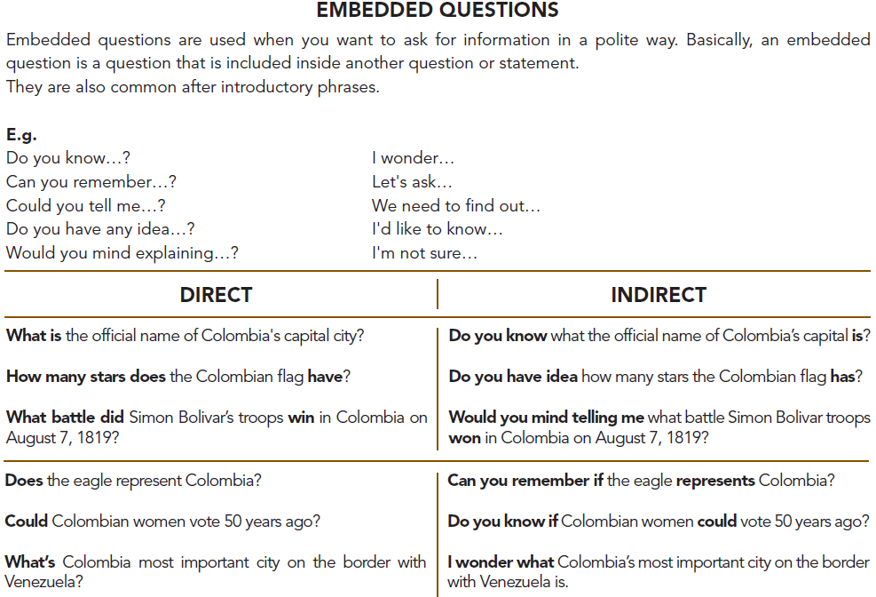

Slide 14
Indirect Questions
EXERCISE

Slide 15
Vocabulary
LET’S REVIEW THE BASIC VOCABULARY
Practice!

Slide 16


